Slide 1
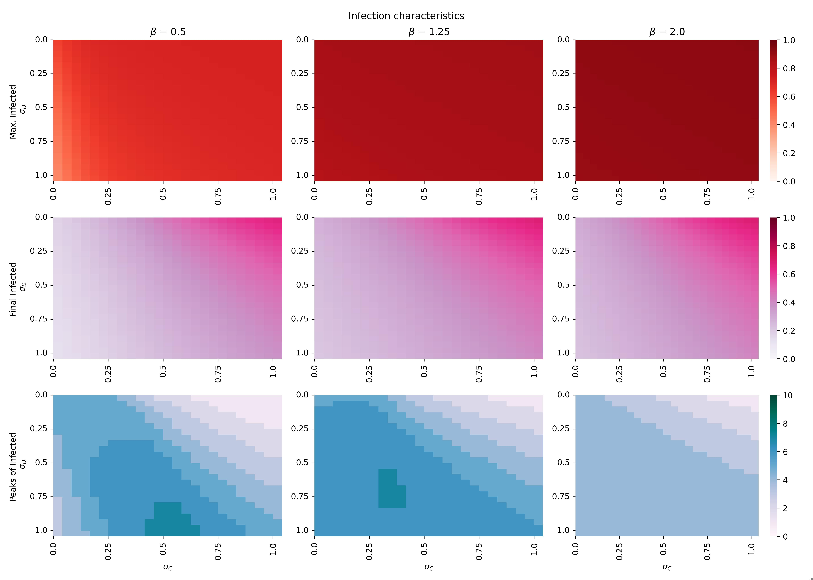
Figure 1 – Heatmaps evolution

Slide 2
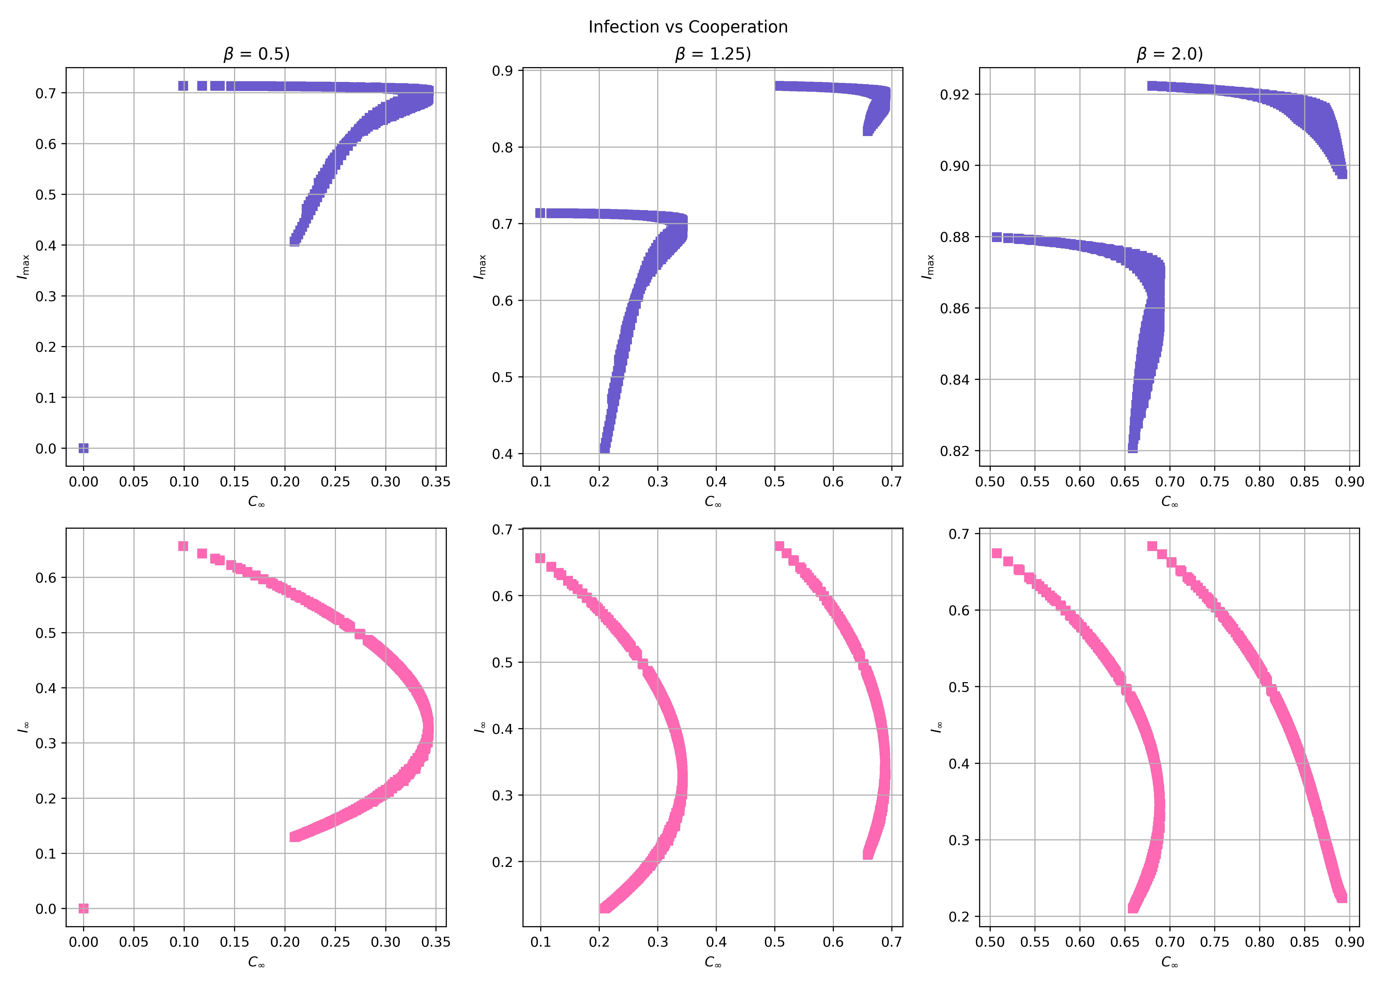
Figure 2 – Correlation between Infection and Decission

Slide 3
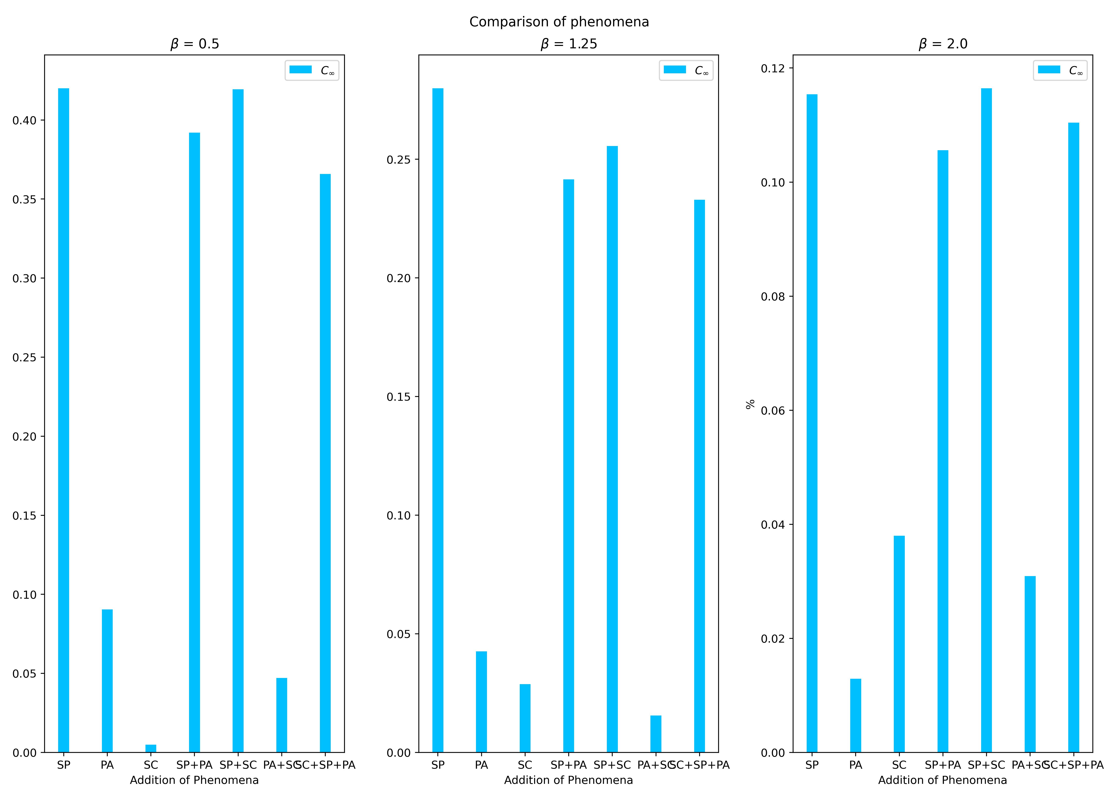
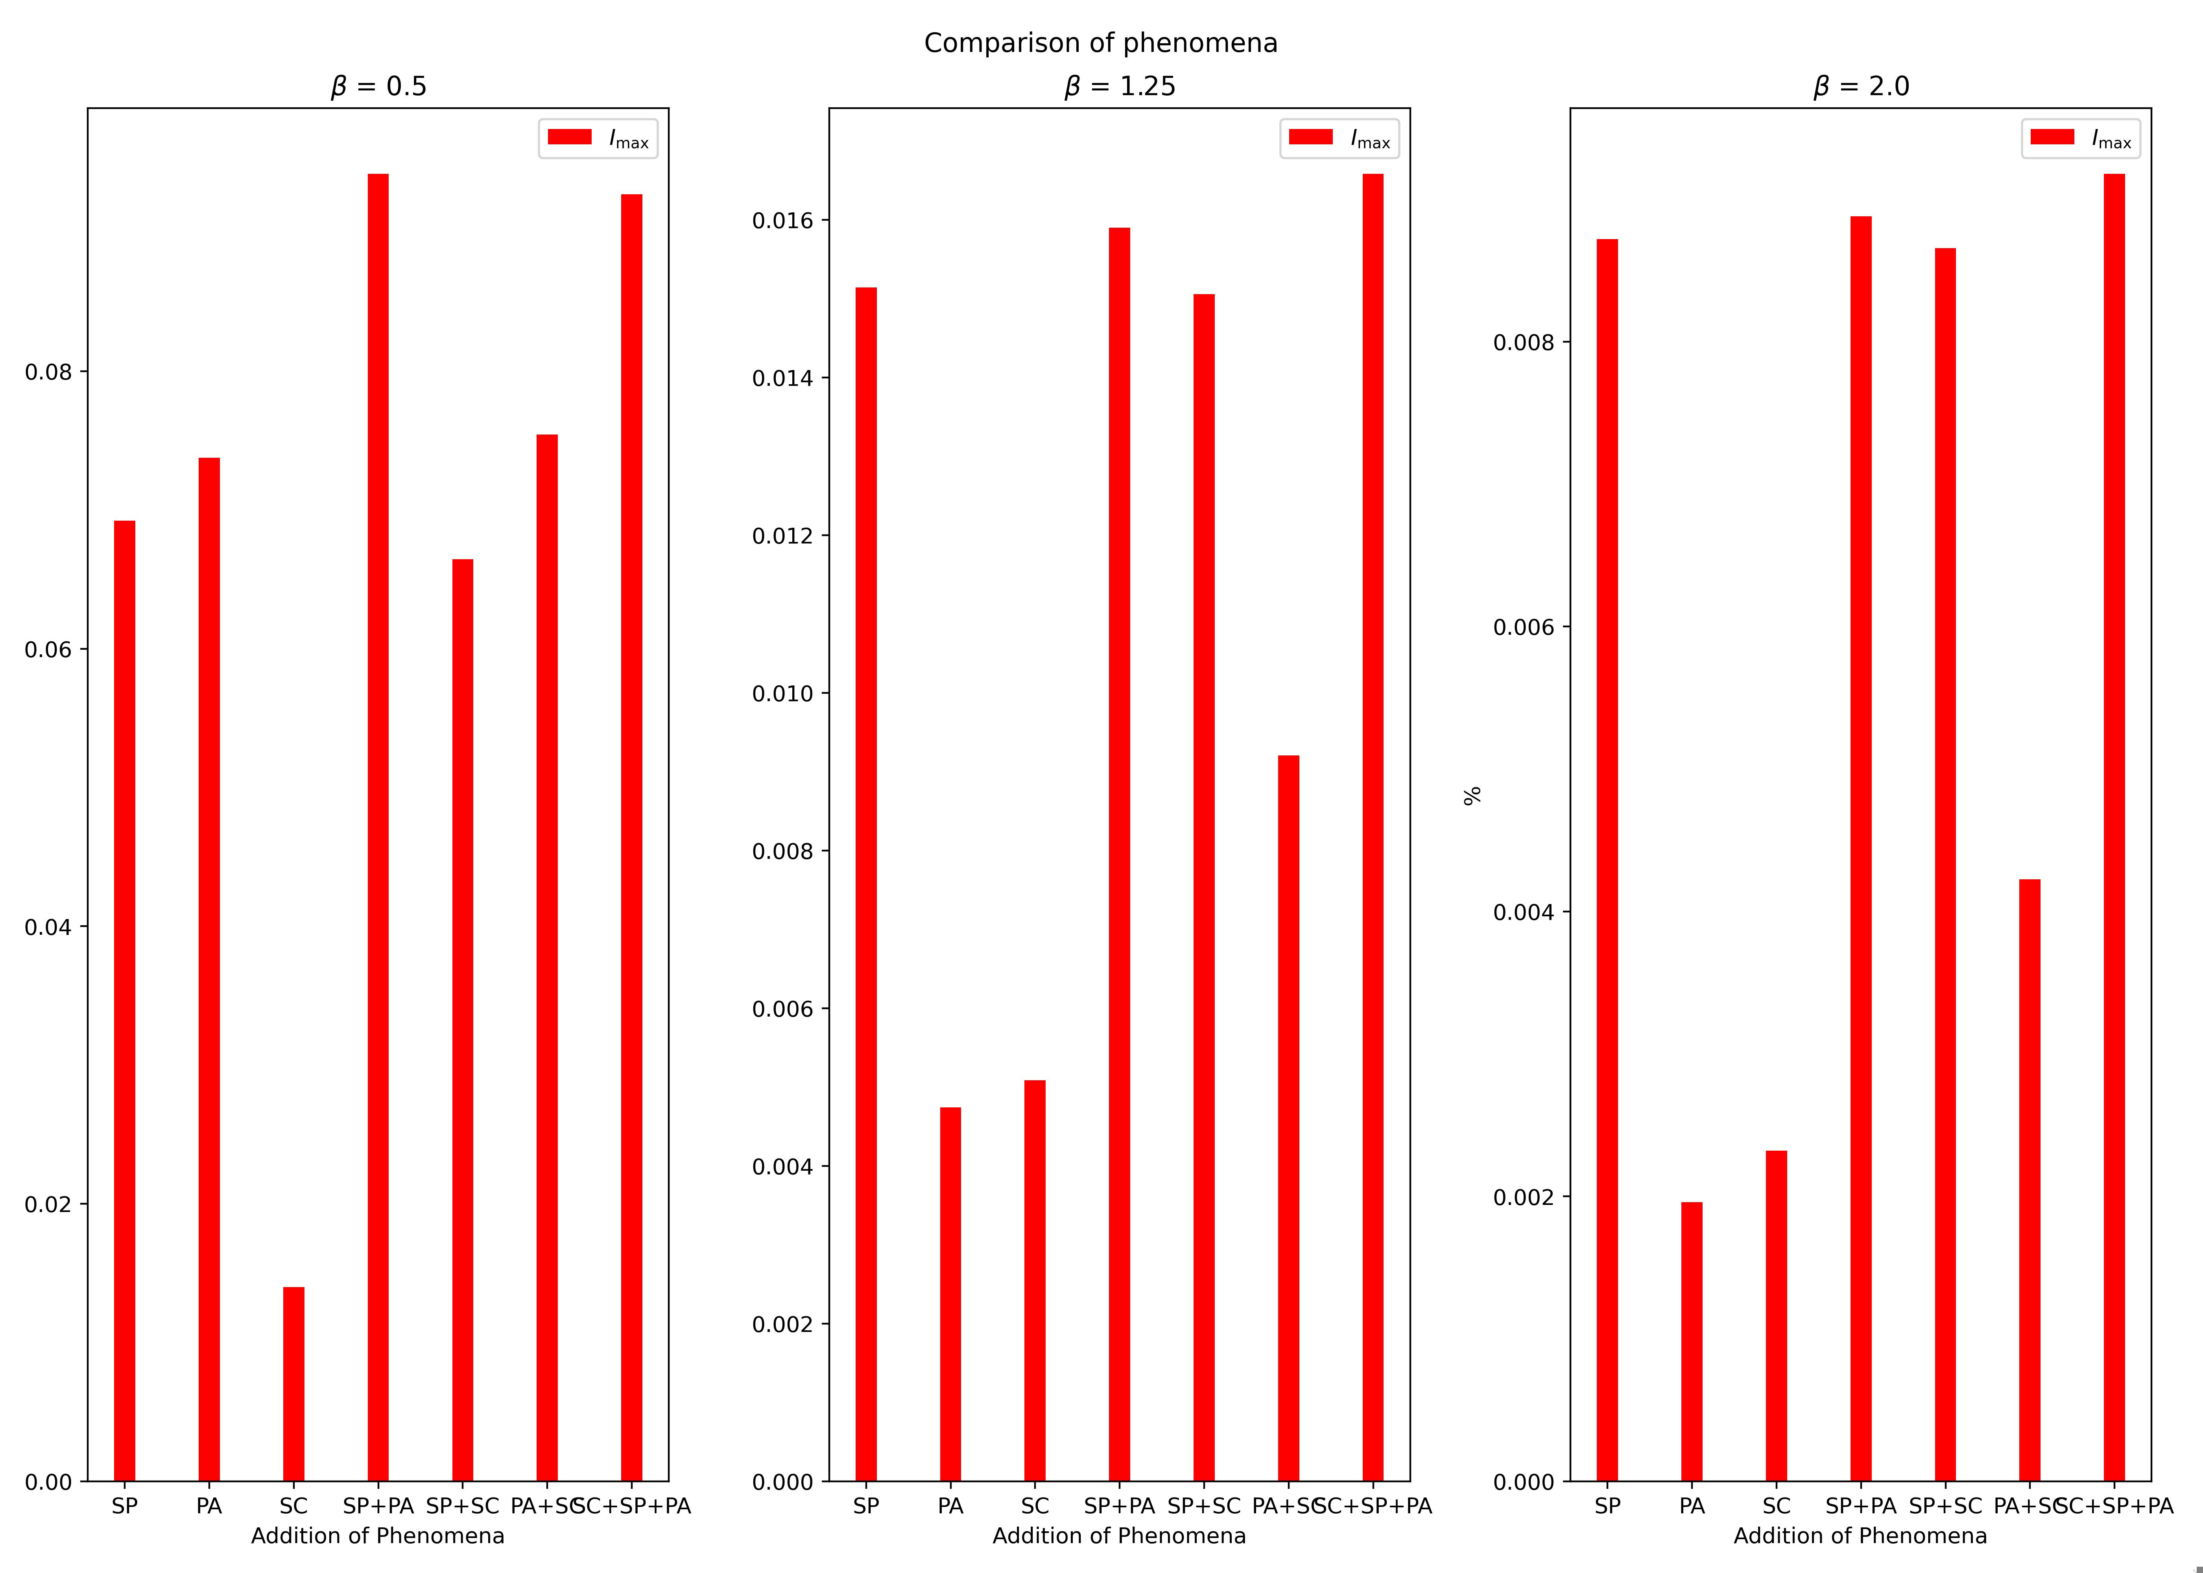
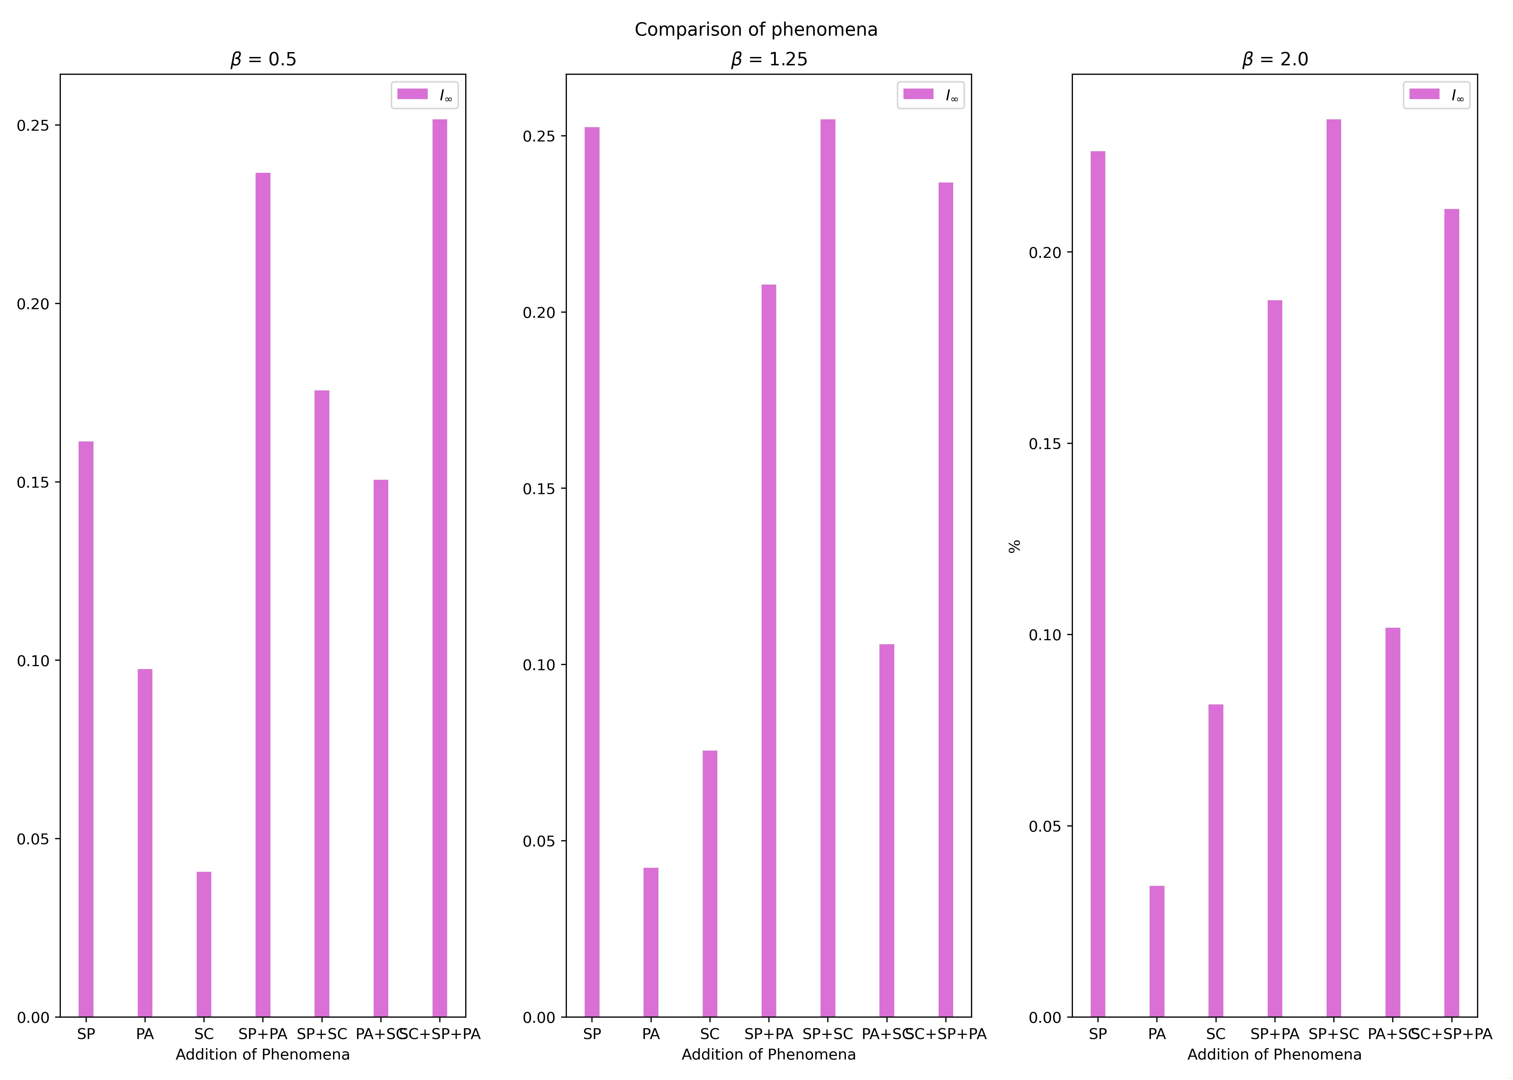
Figure 3 – Barchart of the addition of phenomena

